Slide 1
Scientific Methods
Quiz Review

Slide 2
Quiz Prep Day
The quiz will cover the following objectives and it will be mostly multiple choice with a few short answer questions. Your homework assignments model the types of questions.
How are scientific methods used to answer questions?
What types of observations do scientists gather?
How is a hypothesis formed and tested?
How do scientists design experiments free of bias?
What is a variable and what are some types of variables?
What methods are used to analyze data?
How can a conclusion support or disprove a hypothesis?
What are some methods of communicating data?

Slide 3
Chapter 1.2: Inquiry Process
What are the steps?
1. Make an Observation
2. Ask a question
3. Form a hypothesis
4. Test the hypothesis
5. Collect & Analyze Data
6. Draw Conclusions
7. Communicate Findings

Slide 4
Chapter 1.2: Inquiry Process
What are the steps?
1. Start with an Observation
Use any sense to gather information
Observe a phenomenon
Also include measurements
May occur at any step in the process
At this first step, the observation leads to a question
2. Ask a question
Used to focus the purpose of the investigation
Often follow a set of observations & Observations help focus the question
Question must be observable and measurable

Slide 5
Step 3: Form a Hypothesis

Slide 6
Hypothesis vs. Prediction
Hypothesis is a suggested answer to the question based on scientific information.
As the diameter of the bob increases, the period of the pendulum's swing will increase to to the increase in air resistance. The added air resistance will slow the pendulum.
La hipótesis es una respuesta sugerida a la pregunta basada en información científica.
A medida que aumenta el diámetro de la bobina, el período de oscilación del péndulo aumentará hasta el aumento de la resistencia del aire. La resistencia adicional del aire ralentizará el péndulo.
la variable manipulada es la masa del péndulo
la variable de respuesta es el período del péndulo

Slide 7
Hypothesis vs. Prediction
Prediction is a statement about what will happen to one variable when the other changes.
If the diameter of the bob increases, then the period of the pendulum's swing will increase.
La predicción es una declaración sobre lo que le sucederá a una variable cuando la otra cambie.
Si el diámetro de la sacudida aumenta, entonces aumentará el período de oscilación del péndulo.

Slide 8
Step 4: Test the hypothesis by designing and experiment

Slide 9
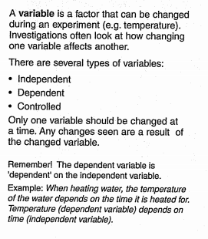
 | What is a variable? Any factor that can change an experiment
 | What is an independent or manipulated variable? The variable that is changed during an experiment
 | What is a dependent or responding variable? The variable that changes and is measured in an experiment
 | What are controlled variables? Variables that are kept constant

Slide 10
 | What is a controlled Experiment? One in which all variables are kept constant except for one (the independent/manipulated) Why do we control variables we are not investigating? Ensure the results were caused by the variable being tested What is the purpose of the experimental control? Provides a baseline for comparison; shows what happens without a change in the variable; validates the data

Slide 11
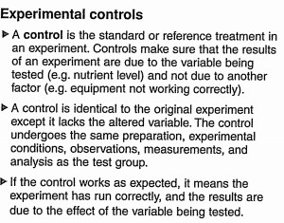
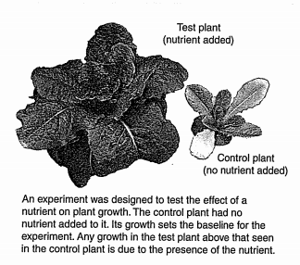

Slide 12
5. Collect and Analyze Data

Slide 13
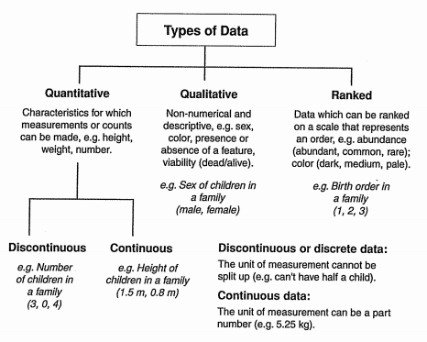
Quantitative Data (Datos cuantitativos)
Qualitative Data (Datos cualitativos)
Ranked (Clasificada)
Discontinuous or Discrete (Discontinua o discreta)
Continuous (Continua)
Control Group (grupo de control)

Slide 14
6. Draw Conclusions- state the answer to the question and support with data; was your hypothesis supported or not? How and why?
7. Communicate Findings

Slide 15
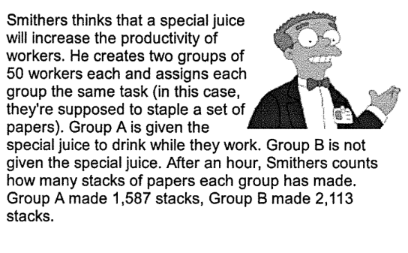
Identify the following:
Manipulated variable-
Responding Variable-
Control Group-
Hypothesis-
Prediction-
conclusion-

Slide 16
Identify the following:
Manipulated variable-
Type of juice
Responding Variable-
productivity
Control Group-
Group B
Hypothesis-The special juice will increase productivity, because the ingredients boost energy.
Prediction- If workers drink the special juice, then their productivity will increase.
Conclusion: The special did not improve productivity, because group B stacked about 500 more papers than group A.

